Slide 1
SUSTAINABILITY UPSKILLING

Slide 2


TABLE OF CONTENTS
01
Our Understanding of your Requirements
02
Approach and Methodology
03
Resources & Commercials
04
Select Case Studies
05
About Capgemini

Slide 3



OUR UNDERSTANDING OF YOUR REQUIREMEENTS
Indus has been on an ESG transformation pathway. Amongst many actions, it has already initiated a sustainability upskilling initiative for its employees. We understand that there are opportunities to strengthen this endeavor which can be supported by Capgemini.
REGULATOR
HOW CAN WE HELP?
Sustainability is both the new digital and the new compliance. Transition risks and opportunities are at the heart of strategic plans; it has become a central topic
UPSKILLING AND EMPOWERING EMPLOYEES
How to sensitize my employees on ESG and align them to the sustainability journey?
Helping all internal stakeholders embed the Group’s sustainability ambitions in their daily decisions :
Develop strong convictions around sustainability
Acquire « green » skills and posture
CLIENTS
Who should be the target audience to sensitize?
What should be the content used to deliver training on Sustainability?
What should be the mode of engagement with employees on this topic?
Lack of knowledge in sustainability is an important barrier to selling green products and services. “Clients Expect Expertise”
CREATING A SUSTAINABILITY CULTURE
Ensure that the culture and working methods at all levels of the company are aligned with the group’s
sustainability ambition
Engage employees (trigger a change in behavior)
EMPLOYEES
40% of employees would quit their jobs if sustainability was not a priority for their company. Sustainability is key to incentivize employee retention
Capgemini has capabilities to support INDUS TOWER IN ITS SUSTAINABILITY UPSKILLING JOURNEY

Slide 4
WE SUGGEST A TWO PHASED APPROACH:
LEARNING MODULE DEVELOPMENT & DELIVERY OF CONTENT
Learning Module Development
Delivery of content to Master Trainers (40 participants)
Master trainers further provide training to employees (3160 participants)
Phase I
(6 WEEKS)
Phase II
(1 DAY)

Slide 5









PHASE 1: LEARNING MODULE DEVELOPMENT
    Our sustainability upskilling approach focuses on creating Learning Modules in consultation with Indus Towers for master trainers
ANALYSIS
DESIGN
DEVELOP
ACTIVITY
Understand the requirement and scope of the training on the specific topic
Using Capgemini’s ESG SMEs/domain experts to build the content and design the curriculum outline
Interview and drive workshops with Indus Towers key stakeholders and content owners per session
SME interaction
Develop content for all the agreed Deliverables
Create Prototype
Review and feedback from Sustainability SMEs and Indus Team
Sign-off from Indus team
INPUT
Training module structure
Training Needs Analysis (TNA) for Train The Trainers (TTT)
Work plan for learning module development
Training Curriculum
Business scenario from business leads/SMEs
Templates, participant’s guide, etc
OUTPUT
Work plan for learning module development
Training Curriculum
Template for participant’s guide
Template for face-to-face training deck
Template for introductory videos, Activity sheets, Assesments
Participant’s guide
Face-to-face training deck for facilitators
TTT tool kit (For details, please refer to slide 9)
ROLES
INVOLVED
Program lead
Instructional Designer
Graphic Designer
SME & Content creators
Client Learning team (SME & L&D)

Slide 6
PHASE 1: PROPOSED MODULES FOR COVERING THE DESIRED CONTENT FOR UPSKILLING
Introduction to the history of ESG and how it has evolved over the years
Understanding the scope of ESG and what it covers
Importance of ESG in today's world and its impact on businesses and society
Identifying the key challenges and opportunities for ESG integration in the business
1
INTRODUCTION TO ESG
Environment: Understanding of environmental impact, such as carbon emissions, water usage, and waste generation
Social: Understanding social impact, such as employee turnover rates, customer satisfaction, and community engagement.
Governance: Understanding governance practices, such as board diversity, executive compensation, & shareholder rights, role of governance structure in ESG review
2
UNDERSTANDING THE DIFFERENT ESG METRICS
Timeline: 1 day
(7 Hours)
Overview of ESG reporting and its importance for businesses
Explain how the ESG Impacts are measured, tracked over time and goals are set for improvement
Introduction to the different frameworks for ESG reporting such as GRI, SASB, TCFD, etc.
Overview of the different types of ESG Benchmarks and how they are used
How to identify and prioritize the key ESG issues relevant to the business
Explain how companies engage with stakeholders on ESG
3
UNLOCKING HOW COMPANIES COMPARE TO EACH OTHER
Introduction to ESG Journey - ESG Governance mechanism, Engagement, Learning & Development, Ideation & Best Practice Sharing, Scorecard, Streams & Stream Leader concept *
Real life studies on successful integration of ESG into the business
The future of ESG and its potential impact on businesses and society
Understanding role of business in shaping future of ESG
4
OUR JOURNEY AND WAY AHEAD
*Subject to content received from Indus Towers

Slide 7


PHASE 2: DELIVERY OF CONTENT TO MASTER TRAINERS
TTT APPROACH
CAPGEMINI TEAM
IMPLEMENT
EVALUATE
Based on the audience size, scope and coverage, we recommend Indus Towers to employ a Train the Trainer (TTT) approach to support the delivery of the training.
Indus Tower will identify participants for the TTT sessions. These users will then deliver training to end users
Capgemini team will ensure effective training means and methods for delivery to trainers
This approach will ensure maximum knowledge transfer and end-user acceptance
Following TTT, the master trainers will lead end user training classes for their assigned patches
ACTIVITY
On premises face to face delivery of the training modules to the master trainers
Post training support
Training evaluation and feedback
INPUT
Face-to-face training deck
Facilitator Notes
Assessment Questions
Introductory Videos
Training experience
Feedback form
INDUS MASTER
TRAINERS (40 participants)
OUTPUT
Face to face training delivery
Evaluation of the training success by analysing the feedback form
ROLES
INVOLVED
INDUS
AUDIENCE (3160 participants)
SME
Program lead
Client Learning team (SME & L&D)

Slide 8




PHASE 2: TTT WILL BE DELIVERED USING PROVEN TRAINING COLLATERALS
Following product types are proposed for master trainers and also for end user training in Indus.
PRODUCT
TYPE
TTT TRAINING DECKS
TTT TOOLKIT
FACILITATOR NOTES:
The notes section of PowerPoint slides will contain talking points, activity ideas, and helpful hints for the trainer.
While conducting an ILT session, the trainer will discuss relevant scenarios to set the context and build relevance before explaining the concepts.
INTRODUCTION VIDEOS:
These Trainer can use explaining WIIFM (What’s in it for me)
Simple animations
2-D stock images and simple graphics, icons
ASSESSMENT QUESTIONS:
Standard Knowledge Assessments at
end of module to reinforce learning
ACTIVITY SHEETS/ ROLE PLAYS:
Activity Sheets/Role plays to make training more interactive.
Slides to be presented in the classroom during an (Instructor Led Training) ILT session: These slides will enable the trainer to present the content as per the course outline.
This includes:
Interactive workshop with process maps, theory, real life examples, etc.
PRODUCT
DESCRIPTION
AUTHORING TOOL:
Microsoft PPT
AUTHORING TOOL:
Microsoft Word
AUTHORING TOOL: Vyond
AUTHORING TOOL: Microsoft Word
AUTHORING TOOL: Microsoft Word
6 hours of Class Room Session Learning delivered over 2 days for
a batch of 25 participants
(TBD with Indus on the final time and duration)
6 hours of Class
Room Sessions
1 or 2 Introduction videos (3—4 minutes)
APPROX.
VOLUME

Slide 9
SUMMARISING THE OVERALL APPROACH
TIMELINE
~1 week
~1 week
~3.5 week
~0.5 week
PHASE
PHASE 1
PHASE 2
ANALYSIS
DESIGN
DEVELOP
IMPLEMENT
EVALUATE
  Understand the requirement and scope of the training on the specific topic in consultation with Indus Tower SMEs
  Using Capgemini’s ESG SMEs to build the content and design the curriculum outline
  Interview and drive workshops with Indus Towers key stakeholders and content owners per session
  SME interaction
  Develop content for all the agreed Deliverables
  Create Prototype
  Review and feedback from SMEs and INDUS team.
  Sign Off from INDUS team
  On premises face to face delivery of the training modules to the master trainers
  Post training support
  Training evaluation and feedback
ACTIVITY
ACTIVITY
ACTIVITY
APPROACH
INPUT
  Participant’s guide
  Face-to-face training deck
  Digital Learning course
INPUT
INPUT
Work plan for learning module development
Training Curriculum
  Business scenario from business leads/SMEs
  Templates, participant’s guide, etc
Training module structure
Training Needs Analysis (TNA) for Train The Trainers (TTT)
  Training experience
  Feedback form
OUTPUT
OUTPUT
Work plan for learning module development
Training Curriculum
  guidelines
Template for participant’s guide, face-to-face training deck
Template for introductory videos, Activity sheets, Assesments
Participant’s guide
Face-to-face training deck for facilitators
TTT tool kit (For details, please refer to slide 9)
  Face to face training delivery
Evaluation of the training success by analysing the feedback form
ROLES
INVOLVED
RESOURCE
Program lead
Instructional Designer
Graphic Designer
SME( Phase 1 includes content creator)
Client Learning team (SME & L&D)

Slide 10
RESOURCE & COMMERCIALS

Slide 11

ASSUMPTIONS & DEPENDENCIES
Capgemini SME & Indus Tower SME will collaborate to create content
Capgemini & Indus Tower SPOCs to finalise on the role and requirements
Content creators will include Instructional Designer and Training Developer
Required review and sign off to be done by Indus Tower
Voiceover audio will be automated tool generated
The training materials would undergo a maximum of 3 iterations. Any further change would impact timelines/cost
The activities to be covered by the Client are the following:
  Training material validation and sign off
  Training material content maintenance beyond the handover of the final training material
  End to end Hosting of Trainings of Master trainers (Identifying participants, sending invitation, all cost related to training like venue, food, logistical arrangement to be borne by Indus)
  Training material print out to be done by Indus

Slide 12
ASSUMPTIONS – Project logistics
Scope of work is limited to the activities mentioned in RFP and clarified during subsequent discussions; and further outlined in the Statement of Work to be entered into by the parties. Any additional activity or deliverable will be subject to a change request, budgets and output for which would be mutually discussed between Indus Tower and Capgemini.
Indus Tower will commit adequate resources and time to the project to ensure that both teams work within scope and meet deadlines to complete the program objectives.
Indus Tower will make available all materials, information access for the project to Capgemini, as needed for smooth functioning and knowledge transfer.
Capgemini will work in their respective offices and will visit the Indus Tower site/office as an when required. We will communicate through available collaboration and communication tools like MS Team or similar, as mutually agreed.
Indus Tower project team will accompany Capgemini consultants during the site visits.
Capgemini will be working on weekdays, from Monday to Friday. Public holidays in India & declared holidays will be available for the project team.
The performance of services, schedules, resources, fees, and expenses provided in this proposal are based upon the assumptions herein. Should these assumptions change, the fees, expenses, and schedule associated with this project may need to be adjusted.

Slide 13
SELECT CASE STUDIES

Slide 14

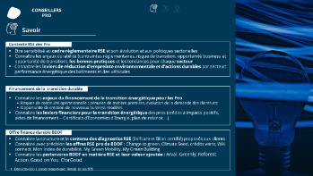
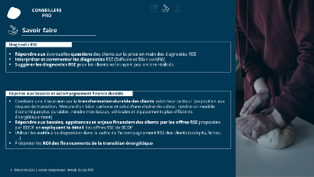
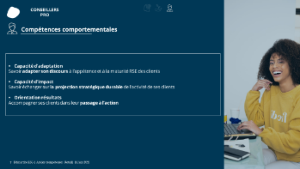
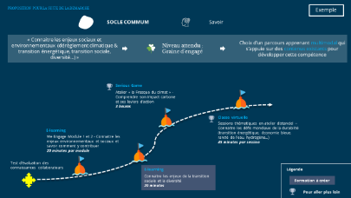
1
Sustainable
Academy
Sustainability Academy for a major player in the banking sector
1
The common core of knowledge for all employees with 4 e-learning modules
SUSTAINABLE ACADEMY
COMMON PATH
“Vision: In 2025, the client is a pioneer of the sustainable transformation, essential for its customers and trademark for its sector.”
CHALLENGES
The customer is the first concerned of his sector on the move towards a more sustainable world, but consumers have difficulty to perceive its commitment
Some consumers are already looking for support in their sustainable transformation
Others feel less concerned, but the client can raise their awareness and anticipate their future needs
3
Specific career paths
OBJECTIVES
25
Priority skills to be acquired by 2023 through new training courses
Build a training program that can bring commitment into its DNA and increase the sustainable skills of all its employees
SOLUTIONS
Construction of a common path with 4 gamified e-learning modules for all employees in order to homogenize knowledge
Definition and writing of scripts for specific courses for the 3 main business lines: Retail, Corporate and Private Banking in order to deepen the knowledge and contextualize it to the different business situations
Support the training process with a change management approach based on the tools, rituals and community already in place with customers
30
Thousands employees trained through at least the Common path

Slide 15



2
Sustainable
Academy
Benchmarck
Sustainability Academy for Total
Webinaire
lancement
3 STAGES APPROACH
CHALLENGES
ONBOARDING
Help collaborators to lead the company's new position by developing common knowledge and a new corporate culture (author of the company's new ambition, and the themes of energy transition, the climate challenge, the electricity​).
INTERVIEW with the deployment manager
2
Collect deployment modalities
Identify the local relay in charge of the operational implementation
SOLUTIONS
Plenary sessions
Kick-Off
Deployment carried by the management without the requirement to be an expert: leaders and managers will animate the sessions thanks to self-supporting animation tools and operational support from Capgemini teams. The objective is to receive this training on site as much as possible.
2
PREPARATION
Detail the deployment methods (schedules, division of groups, etc.)
Build the custom deployment kit
EXPECTED RESULTS
Workshops
Time Flight 1
6-8
Weeks
1
DEPLOIEMENT
Stop-over 1
Carry out stopovers in line with the tailor-made schedule
Provide ongoing operational support
Offer the possibility to be on site during face-to-face training, if necessary, worldwide
Time Flight 2
2
Stop-over 2
Thanks to a tailor-made deployment kit adapted to the needs of each Deployment Manager and continuous support throughout the training, we give the keys to the customer teams to carry out the training successfully.
Time Flight 3
3
Stop-over 3

Slide 16

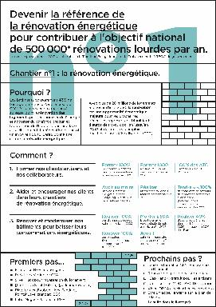
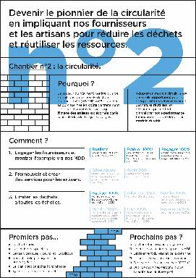
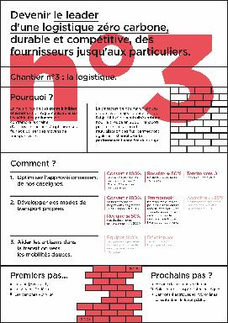
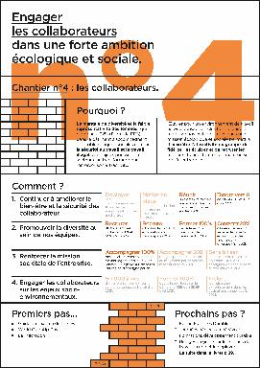
4
Sustainable
Academy
Benchmarck
Sustainability Academy for
Saint-Gobain
30
OBJECTIVES AND CONTEXTS
Identify themes and mechanisms to bring out innovative and sustainable solutions
SOLUTIONS
Analysis of CSR impacts and risks on the value chain and associated economic opportunities;
Raise COMEX awareness of to the environmental issues of the sector + Workshop creation on the ambition and actions of the group's roadmap;
Workshop co-creation with the 40 (corsairs) privateers identified;
Definition of 4 priority action projects around: energy renovation, zero carbon supply chain, circularity, employees;
Address the manifesto embodying the social and environmental ambition of SGDBF, create the tools needed to spread this ambition and enable the 23,000 employees to make their live this ambition in their jobs.
Interviews
with COMEX-level people and Ambassadors
4
Achievements
Identified sites, action/site plan, quantified objectives defined in co-construction with the COMEX and the ambassadors

Slide 17
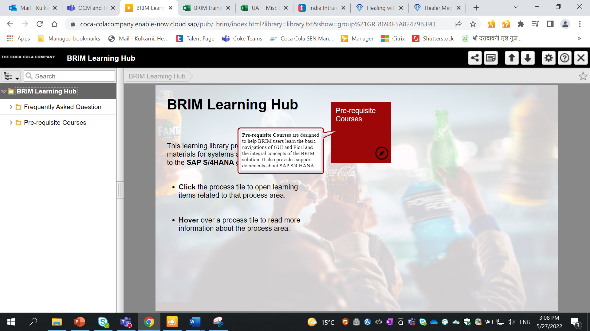
Project Wilbur: Learning and Adoption Program for SAP BRIM For For US Based Beverage Company
5
CLIENT CHALLENGE
Client wanted to execute a learning and adoption program for their newly implemented SAP BRIM platform
Needed a Structured Learning Program that targets the skill development of TCCC employees.
The high-level objective of this program was to use the SAP BRIM platform seamlessly for the Billing and Reimbursement related OTC processes.
A Learning Program aligned with the Contour Learning Program (a separate division) but can also be executed independently.
SOLUTIONS
The solution proposed included a blended-learning approach to enhance the learning and adoption experience.
Development of a Learning Hub that shelters Instructor-led training as well as self-paced learning resources.
The combination of content pages and SOPs to deliver the knowledge of new BAR processes.
Development of a variety of Demo and Practice simulations to ensure optimal learning and acquisition of new skills in users
Structured learning to support the needs of the deployed users
Achievements
Developed a training environment called the LEARNING HUB, a one-stop shop for all training resources. blend of
Instructor Led Training Web-based modules, SOPs, and Job Aids,
Created Demo-simulations for classroom training, and Practice Simulations followed by Assessments.

Slide 18
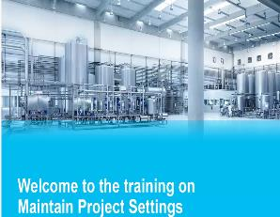
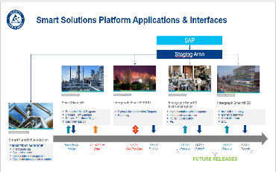
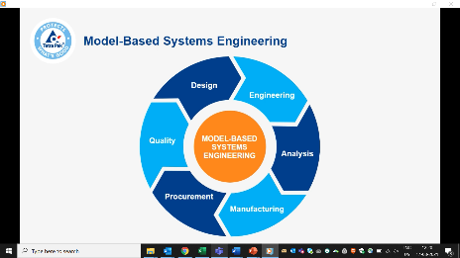
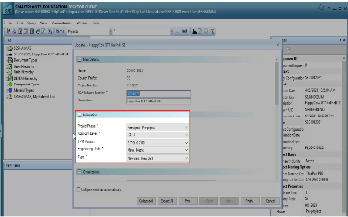
6
Learning creation for Swedish–Swiss multinational food packaging and processing company
CLIENT CHALLENGE
The client wanted to create a digital learning ecosystem that would enable their workforce to successfully leverage the new platform.
They needed a comprehensive training plan and effective training material for the new application, which could effortlessly train their existing staff and new joiners.
The ask also included providing the training to the end users.
SOLUTION
Created a training curriculum to coach the client workforce in the usage of the new tool
Training material included self-paced demonstration videos, concept decks and VILT (virtual instructor-led training) package. The VILT package comprised of facilitator decks, exercises and FAQ documents.
The Capgemini trainer worked in sync with the client team to provide the training to the end users.
Achievements
The client workforce could understand the new application effortlessly.
The VILT package comprised of facilitator decks, exercises and FAQ documents
The VILT was well-received and met the overall training objective.
The end users were ready to use the new tool.

Slide 19
About Capgemini
Capgemini is a global leader in partnering with companies to transform and manage their business by harnessing the power of technology. The Group is guided everyday by its purpose of unleashing human energy through technology for an inclusive and sustainable future. It is a responsible and diverse organization of over 360,000 team members more than 50 countries. With its strong 55-year heritage and deep industry expertise, Capgemini is trusted by its clients to address the entire breadth of their business needs, from strategy and design to operations, fueled by the fast evolving and innovative world of cloud, data, AI, connectivity, software, digital engineering and platforms. The Group reported in 2022 global revenues of €22 billion.
Get The Future You Want | www.capgemini.com

